Slide 1
Patvēruma meklētāju uzņemšanas sistēma Norvēģijā
Marit Sjaastad
Norvēģijas Imigrācijas direktorāta īpašā padomniece

Slide 2
Patvēruma meklētāji Norvēģijā,
2014. un 2015. gads
Patvēruma pieteikumi, 2015.: 31 150
Patvēruma pieteikumi, 2014.: 11 480
Nepavadīti nepilngadīgie, 2015: 17 %
Prognoze par 2016. g.:
33 000 (jauna prognoze būs februārī)

Slide 3
Nepavadīti nepilngadīgie (NN)
2014. un 2015. g.
2015: 5296 NN
2014: 1204 NN

Slide 4
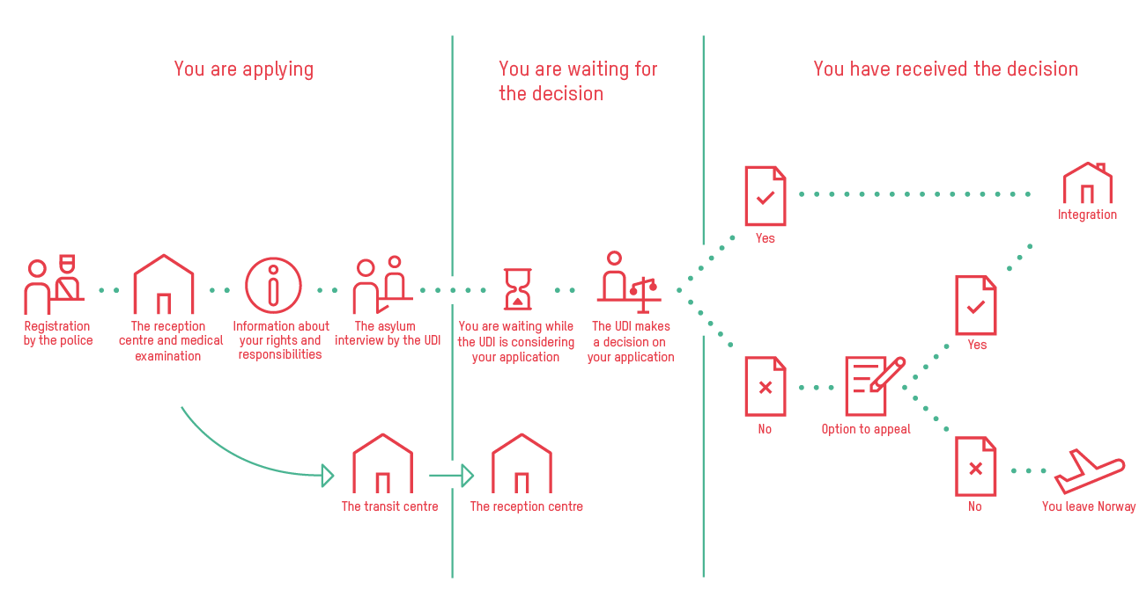
Patvēruma lūgšanas process
Notes:
There are no spesial arrangements for irregular UAMs who do not apply for asylum. However, The Child Welfare Services are oblidged to take care of any child in need in Norway, also irregular immigrants.
Registration of asylum application takes place at the National Police Immigration Service in Oslo. This means that asylum seekers who approach other offices (i.e. police stations, border guards) are either referred to PU or transported to their offices.

Slide 5
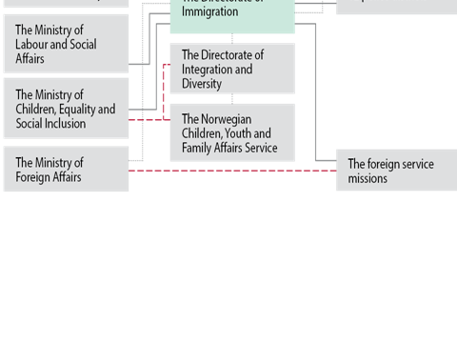
Lēmumi par patvēruma pieteikumiem, 2014. un 2015. g.

Slide 6
Iemītnieki uzņemšanas centros un viņu pieteikuma statuss

Slide 7
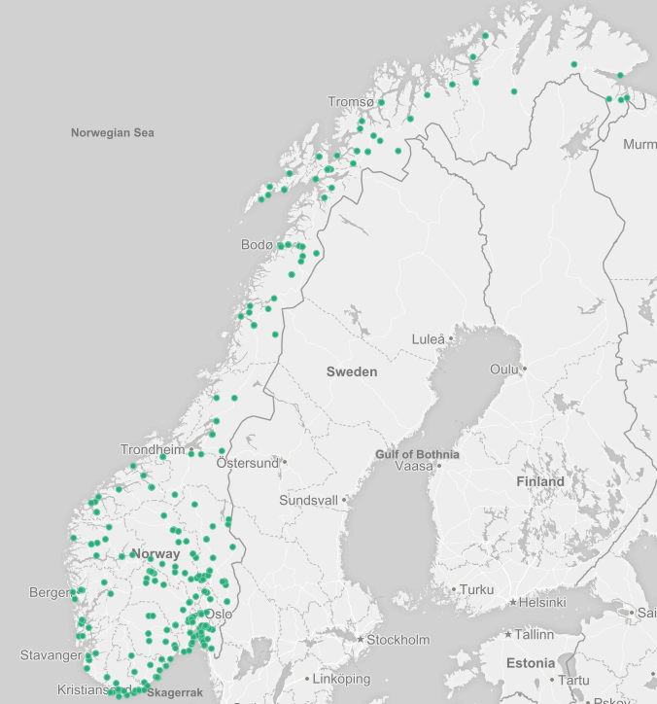
Uzņemšanas centri, uz 04.01.2016.
Centri 184 pašvaldībās, 105 pārvaldnieki
110 parastie centri
11 pārejas centri
99 ārkārtas centri
10 pārejas centri nepavadītiem
nepilngadīgajiem (NN)
35 parastie centri nepavadītiem nepilngadīgajiem
_______________________
ar
28 nodaļām, kas paredzētas NN
4 nodaļām cilvēkiem ar īpašām vajadzībām
Kopā:
44 704 vietas
29 224 iemītnieki
Notes:
Prikkene er oppdatert per 18. november.
Plasser og beboere er per 4.1.2016

Slide 8
Diferenciēti centri atkarībā no patvēruma meklēšanas procesa un mērķa grupas
Ierašanās centri
Pārejas centri laikposmam līdz patvēruma meklētāja intervēšanai
Parastie centri, visā Norvēģijā
Centri nepavadītiem nepilngadīgajiem (NN) vecumā no
15 līdz 18 gadiem
Aprūpes centri NN, kas jaunāki par 15 gadiem
Īpašas nodaļas personām ar fiziskām vai psiholoģiskām vajadzībām (tās nav slimnīcas/medicīnas iestādes)
Notes:
Arrival center: 2 new centers autumn 2015,- 1 near Oslo (towards the border to Sweden and 1 in the north of Norway towards the border to Russia)
All newcomers for stay there a couple of days for inprocessing, registration and mandatory tubercolosis examination
They are then moved to Transit centers located in the vicinity of Oslo ( within 2 hours drive from Oslo) where they stay until the asylum interview has taken place. However, this was the situation before autumn 2015
Following the initial screening and asylum interview, the majority of asylum seekers are transferred to ordinary reception centers geographically dispersed across the entire country.
According to special needs or characteristics, some are transferred to various specialized centers, such as unaccompanied minors, persons with physical or mental problems.
Persons in Dublin procedure are not dispersed to centers across the country, but stay in transit centers or other designated centers in order to be returned. (in times of increased influx of newcomers, this group may be dispersed to ordinary centers due to capacity challenges in centers near Oslo)
The ordinary centers varies with different degrees of «centralization». Some centers are organized as a campus in more institutional buildings where both families and singles are accomodated, while others are more decentralized which implies that asylum seekers are accomodated individually either in houses or in flats.
Persons who have received a final negative decision on their asylum application are offered accomodation in reception centers until they have returned voluntarily, have been assisted by IOM (VARP) or have been returned by the police (forced return).
(focus on return program in reception centers from arrival and throughout the entire stay)
Persons whose asylum request has been rejected, but who have remained illegally, or persons who have a criminal record, may be detained in a closed detention center until expulsion has taken place.
Programme and activities in the centres
Information programme
Returninformation, councelling and activities
Settlement preparations
Kindergarden/School/ Work
Participation at the centre: residents cooperation council
Activities for children and for adults
Mandatory information programme:
-Norwegian society and values
-rules and regulations, code of conduct
-arrival information ,
-information preparing for settlement of residents who have been granted a residence permit,
-return information
Kindergarden: for 4-5 year olds
School: Elementary school in the host municipality, minors between 16 and 18 have the right to 250 hours of Norwegian courses – the same as adult asylum seekers
Work: Asylum seekers who have documented their identity can apply for a temporary work permit
Residents participation:
Give residents influence on decisions that directly influence their day-to-day lives.
Resident’s cooperation council: the head of the council and at least two thirds of the participants must be residents

Slide 9
Jauna uzņemšanas struktūra?
2015. gada rudenī 2 mēnešu laikā ieradās 10 000 jauni patvēruma meklētāji, un 2016. gadā tiek prognozēta līdzīga situācija, tāpēc jāplāno jauni risinājumi. Tas ietvertu lielākus un cita veida centrus un jaunu sadarbības modeli starp dažādām iesaistītajām pusēm.
(Starp attiecīgās jomas direktorātiem, pašvaldībām, brīvprātīgajām organizācijām, privātajiem partneriem u.c.)

Slide 10
Uzņemšanas centru vadīšanas pienākumu sadalījums – 3 galvenās iesaistītās puses:
Valsts ar Imigrācijas direktorāta starpniecību –nodrošina, lai vienmēr būtu pietiekams uzņemšanas vietu skaits, kā arī noteikumiem atbilstoša pienācīga kvalitāte
Uzņemšanas centru pārvaldnieki – pēc izraudzīšanas konkursa kārtībā vada uzņemšanas centrus
Uzņemošā pašvaldība – koordinē pakalpojumus patvēruma meklētājiem, kuri uzturas uzņemšanas centrā attiecīgajā pašvaldībā
Dažādi pārvaldnieki (pašvaldības, NVO, komercorganizācijas) nodrošina elastīgumu, efektivitāti un kvalitāti
Notes:
Norway has implemented the EU’s public procurement directive in a way that also includes the running of reception centres
In short: Every new reception centre shall be subject to competition, so that public contracts are as cost effective as possible
Thus: Anyone can run a reception centre as an award of a public service contract.
As there is no regulation by law, the providers compete on the basis of instructions set by UDI
The contract obliges the service provider to maintain the given quality for the price offered and it obliges UDI to regular payments, guidance and training for employees
The contracts also gives UDI the right to audit the service
The Norwegian model gives the State the opportunity to opt to run reception centres directly or to outsource the running of the centres. There has been a debate whether the State should run directly the initial arrival centre and centres specialized to accommodate finally rejected asylum seekers, but the Directorate of Immigration has so far opted to outsource all types of centres.
Responsibility for the running of reception centers is contracted to operators, public and private (municipalities, commercial actors and NGOs), of which the majority are commercial actors.
Experience has shown that a balance between the different type of operators is beneficial when it comes to the fulfillment of the various requirements such as :
-Flexibility – the ability to increase or decrease capacity rapidly:
Commercial actors have proved to be flexible and managed to fulfill requirements in tender procedures often within short timeframes when upscaling
-Efficiency and costs – competition gives lower price
-Quality of services and integration in main stream society
Municipalities provide inhabitants with services, may have a long term and wholistic approach to the task of running reception centers.
NGOs – already a strong role in society, often members/local branches in municipalities and humanitarian profile in line with the task of running centers

Slide 11
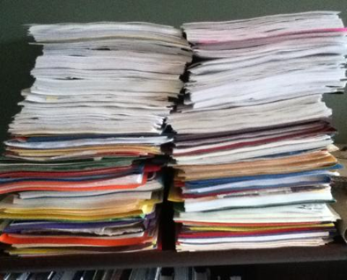
Norādījumi uzņemšanas centriem
Likumos sniegts tikai viens norādījums:
«Patvēruma meklētājiem ir jāpiedāvā izmitināšana» (Imigrācijas likuma 95. p.).
Instrukcijas sniegtas UDI dokumentos, kas īpaši paredzēti uzņemšanas centriem (rundskriv).
Notes:
§ 95 in the Immigration Act
Reception centres are in general not regulated by law.
Instructions/regulations/requirements are found in other kind of documents.
Almost 50 different documents regulating the field of reception centres, cover topics such as:
Administrative matters (submission of various documents, planning, reporting).
Economic matters (reimbursement from UDI, budget, accounting, resident economy).
Organizational matters (staffing, ethics, training for employees, cooperation with different partners/services etc).
Accommodation (common areas, fire safety, safety in general etc).
Work related directly to the residents:
In general (information, return, settlement, resident participation, activities)
Specific groups (children, women, disabled, elderly, unaccompanied minors).

Slide 12
Uzņemošās pašvaldības pienākumiem
Pašvaldības pienākums ir nodrošināt:
- veselības aprūpi;
- bērnu aprūpi;
- izglītību nepilngadīgajām personām;
- norvēģu valodas apmācību pieaugušajiem.
“Uzņemošās pašvaldības kompensācija” sedz vidējās izmaksas
Notes:
Nursery: the UDI gives grants to nurseries that enroll children (4-5 years old) living in reception centres.
Elementary school: children between 6-15 years living in ordinary reception centres and care centres have a right and a duty to go to elementary school – if it is likely that the child will stay in the centre for more than three months. The municipality can apply for a grant from the UDI. The grant shall also cover lessons in the children’s mother tongue. Children between 16 and 18 can also get elementary education if they haven’t got the equivalent education already, if the municipality can offer it

Slide 13
Prasības uzņemšanas centriem
- Attiecas uz visiem uzņemšanas centriem, arī tiem, kas paredzēti NN.
Visiem iemītniekiem nepieciešama gulta, kur gulēt.
Slēdzamas vannasistabas un tualetes, ir koplietošanas telpas socializēšanās vajadzībām, pielāgotas pēc dzimuma un vecuma.
Apmierinoši higiēniskie dzīves apstākļi.
Pieejama veļas mazgājamā mašīna.
Ir iespēja pašiem gatavot maltīti vai tiek piedāvāts barojošs, daudzveidīgs un attiecīgajai kultūrai piemērots ēdiens.
Notes:
The reception center has the caring responsibilities for the unacccompanied minors. They have the daily support and guidance and creates a home for the uams.

Slide 14
……….
Informācijas programma
Informācija par atgriešanos un aktivitātes
Gatavošanās izmitināšanai
Līdzdalība/ iemītnieku sadarbības padome
Aktivitāšu programma pieaugušajiem
Aktivitātes bērniem
Konfliktu risināšana un novēršana
Sadarbošanās ar vietējo sabiedrību un brīvprātīgajām organizācijām
Notes:
For adults: It shall include leisure activities such as sports and hobbies, and communal activities – voluntary.
Cooperation with local community, neighbourhood voluntary organizations to offer activities and network

Slide 15
OBLIGĀTĀ INFORMĀCIJAS PROGRAMMA
- Norvēģijas sabiedrība un pamatvērības
- Ietver informāciju par ievadprogrammu, tiesībām un pienākumiem
- Informācijas sagatavošana par to iemītnieku izmitināšanu, kuriem piešķirta uzturēšanās atļauja
- Informācija par atgriešanos, pielāgota dažādu grupu vajadzībām.

Slide 16
Gatavošanās izmitināšanai un integrēšanai
Kvalifikācijas un prasmju apzināšana
Ģimenes tīkla apzināšana Norvēģijā
Izglītība un darba pieredze – pārnese un apstiprināšana
Karjeras plānu apzināšana
Norvēģijas kultūra, tiesības un pienākumi
Valodas apmācība
Jauni projekti, kas veicina integrēšanos
Notes:
New projects: Cooperation with voluntary organizations, private enterprises, municipalities and reception centers

Slide 17
Gatavošanās atgriešanās procesam
Atbalstītās brīvprātīgās atgriešanās programma (AVR) – sadarbībā ar Starptautisko Migrācijas organizāciju (IOM)
Informācija un individuālas konsultācijas par atgriešanos – programma visos uzņemšanas centros

Slide 18
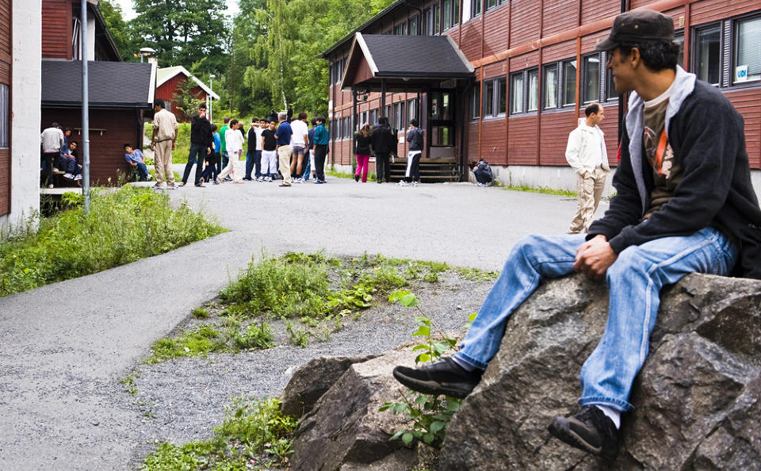
Aprūpe un izmitināšana
Notes:
Generally a higher standard than other reception centres
Have more activities
Staff present 24 hours a day
Have a special focus on the rights and needs of unaccompanied minors
Must help guardians deal with their responsibilities and duties for minors

Slide 19
Prasības – centri, kas paredzēti NN
Nodrošināt pēc iespējas normālāku dzīvesvietu nepilngadīgām personām šai sarežģītajā dzīves situācijā
Izkopt un atbalstīt personas individualitāti, piederības sajūtu un pašpaļāvību
Nodrošināt vienkāršus, bet standartiem atbilstošus apstākļus
Apmierināt iemītnieku pamatvajadzības
Nodrošināt aizbildņus visām nepilngadīgajām personām

Slide 20
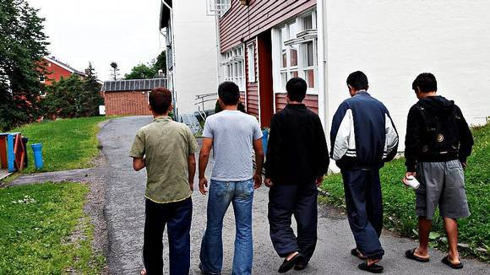
Izaicinājumi uzņemšanas centriem
Notes:
-Inadequate conditions - long term residents
Conditions in the centers are adequate for short term stay, not for long stay. Many stay long in the centers due to lack of capacity in the UDI (Interview and case handling) and in municipality (housing ++)
Long stay has often a negative impact on residents awaiting settlement in a municipality and as well on rejected asylum seekers that do not return voluntarily and are waiting for the police to return them by force. Some belonging to the last group decides to leave the centers without telling.
- Managing capacity and occupancy requirements (85% occupancy) in times of changes in influx .
- Preparedness for uncertain prognosis
- UAMs Disappearing
Each year there is a number of residents who disappear from the centers for UAM. National and local media cover the subject extensively.
The centers are open and the minors are not held by force. It means that they can leave if they wish and when they wish.
The centers are required to follow detailed guidelines on how they should proceed in case a minor resident disappears. When is suspicion that the minor disappeared the center must immediately report it to the local police and inform the local child services, so that the investigation can start.
Usually the investigation is difficult because of lack of information. The centers do not always know for sure why minors leave centers: if they are forces to do so, if they are in danger or choose it freely.
There are several problems with the system. One is lack of information, the other insufficient follow-up from local child services, yet another - insufficient coordination between different agencies and unclear allocation of responsibilities.
- Victims of trafficking
For the reception centres, the main task and purpose is to support the victims in their struggle for physical, psychological and social recovery.
The reception centres are not a part of the migration administration, and therefore have no duty to examine the residents’ case. It is therefore not a prerequisite to be verified as a victim to receive help and protection at the reception centres. Instead every one person that is identified as a possible victim of trafficking, and in any case there are reasonable grounds for believing a person is a victim, this resident is entitled to help and protection.
However, the reception centres do have a duty to abide by the requirements set forth by UDI, and the reception centres are required to help identify victims of trafficking within the reception centre system.

Slide 21
Paldies par uzmanību!
Marit Sjaastad
masj@udi.no

